Slide 1
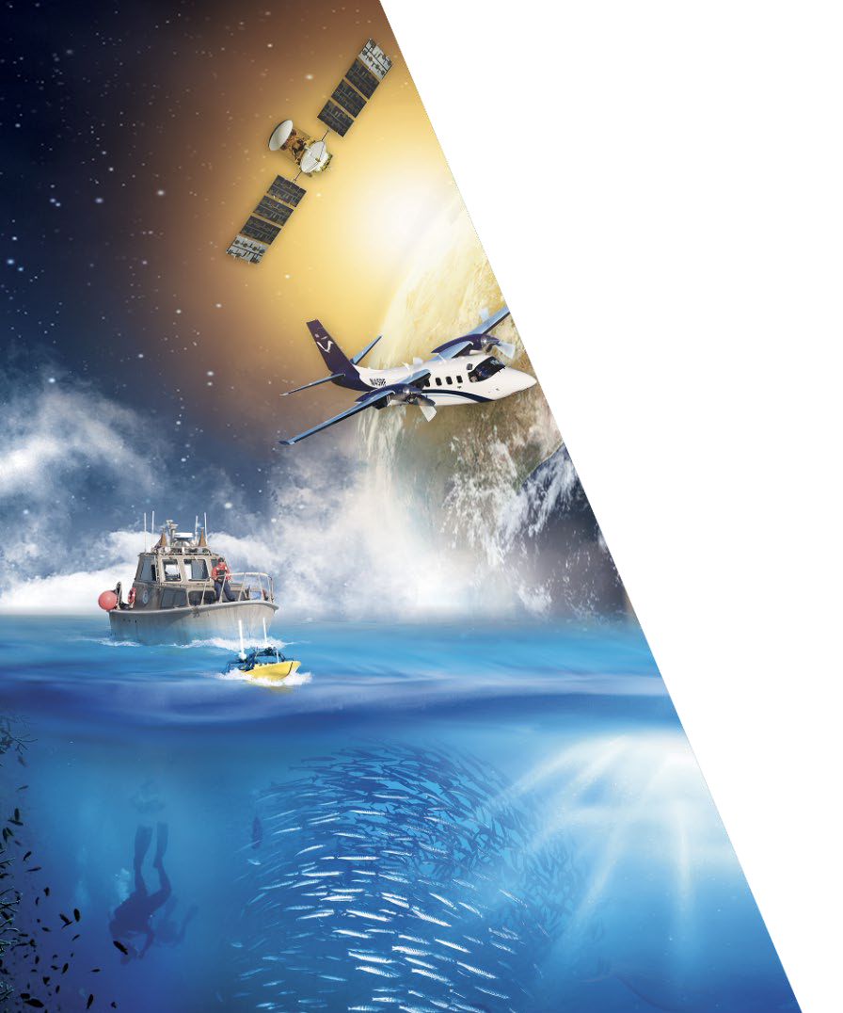





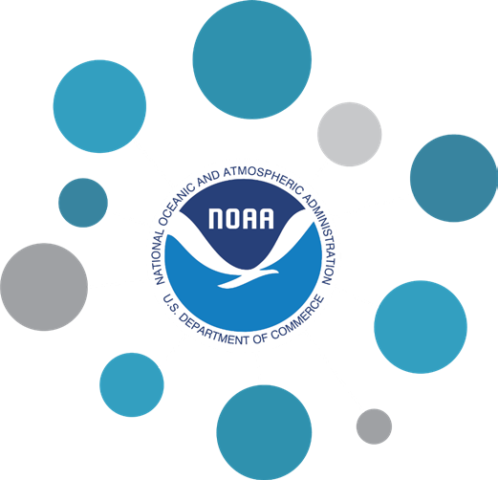

AQUAVIEW+: Cloud Enabled Data Assembly and Dissemination System
National Oceanic and Atmospheric Administration ⎸National Centers for Environmental Information
1

Slide 2
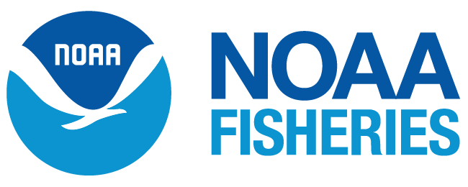
Statement of Need: NOAA Fisheries Data Management
NOAA Fisheries Needs:
Getting people to move to and leverage the Cloud
Improving independent understandability and interoperability across NMFS as data are collected and managed in unique formats and variables
Appropriately handling and providing access to commercially sensitive or PII data
Managing large video and acoustics data
Archiving ‘Omics data and other data that are currently not in scope for NCEI
Meeting PARR and NARA archiving and records management requirements for broad availability, independently understandable, and reusable across sectors, communities, and generations
Providing a common data framework across Fisheries Science Centers and Regional Offices

Slide 3
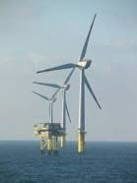
Objective
Objective: To rapidly transform NOAA’s infrastructure and tools for archive, access, and usability of ocean data and unlock the full potential of past and future observations.
The Initiative will build off AQUAVIEW’s existing federated platform to fully leverage the cloud, resulting in expanded use of NOAA data in critical decision support contexts from climate adaptation to ecosystem resilience. With centralized access to NOAA Fisheries petabyte-sized holdings of data, scientists and resource managers will be able to more comprehensively and more quickly find and take advantage of disparate data for report generation, analysis, and other needs as identified as the Data Assembly Hub comes online.
The OCEAN Initiative will further support the extensive offshore wind energy development that is ramping up on the east coast of the U.S. by providing vital baseline information, and pioneering the methodology to centralize large volumes of data collected by various data providers in a cloud environment integrated with standardized data processing that could be leveraged by this community.

Slide 4
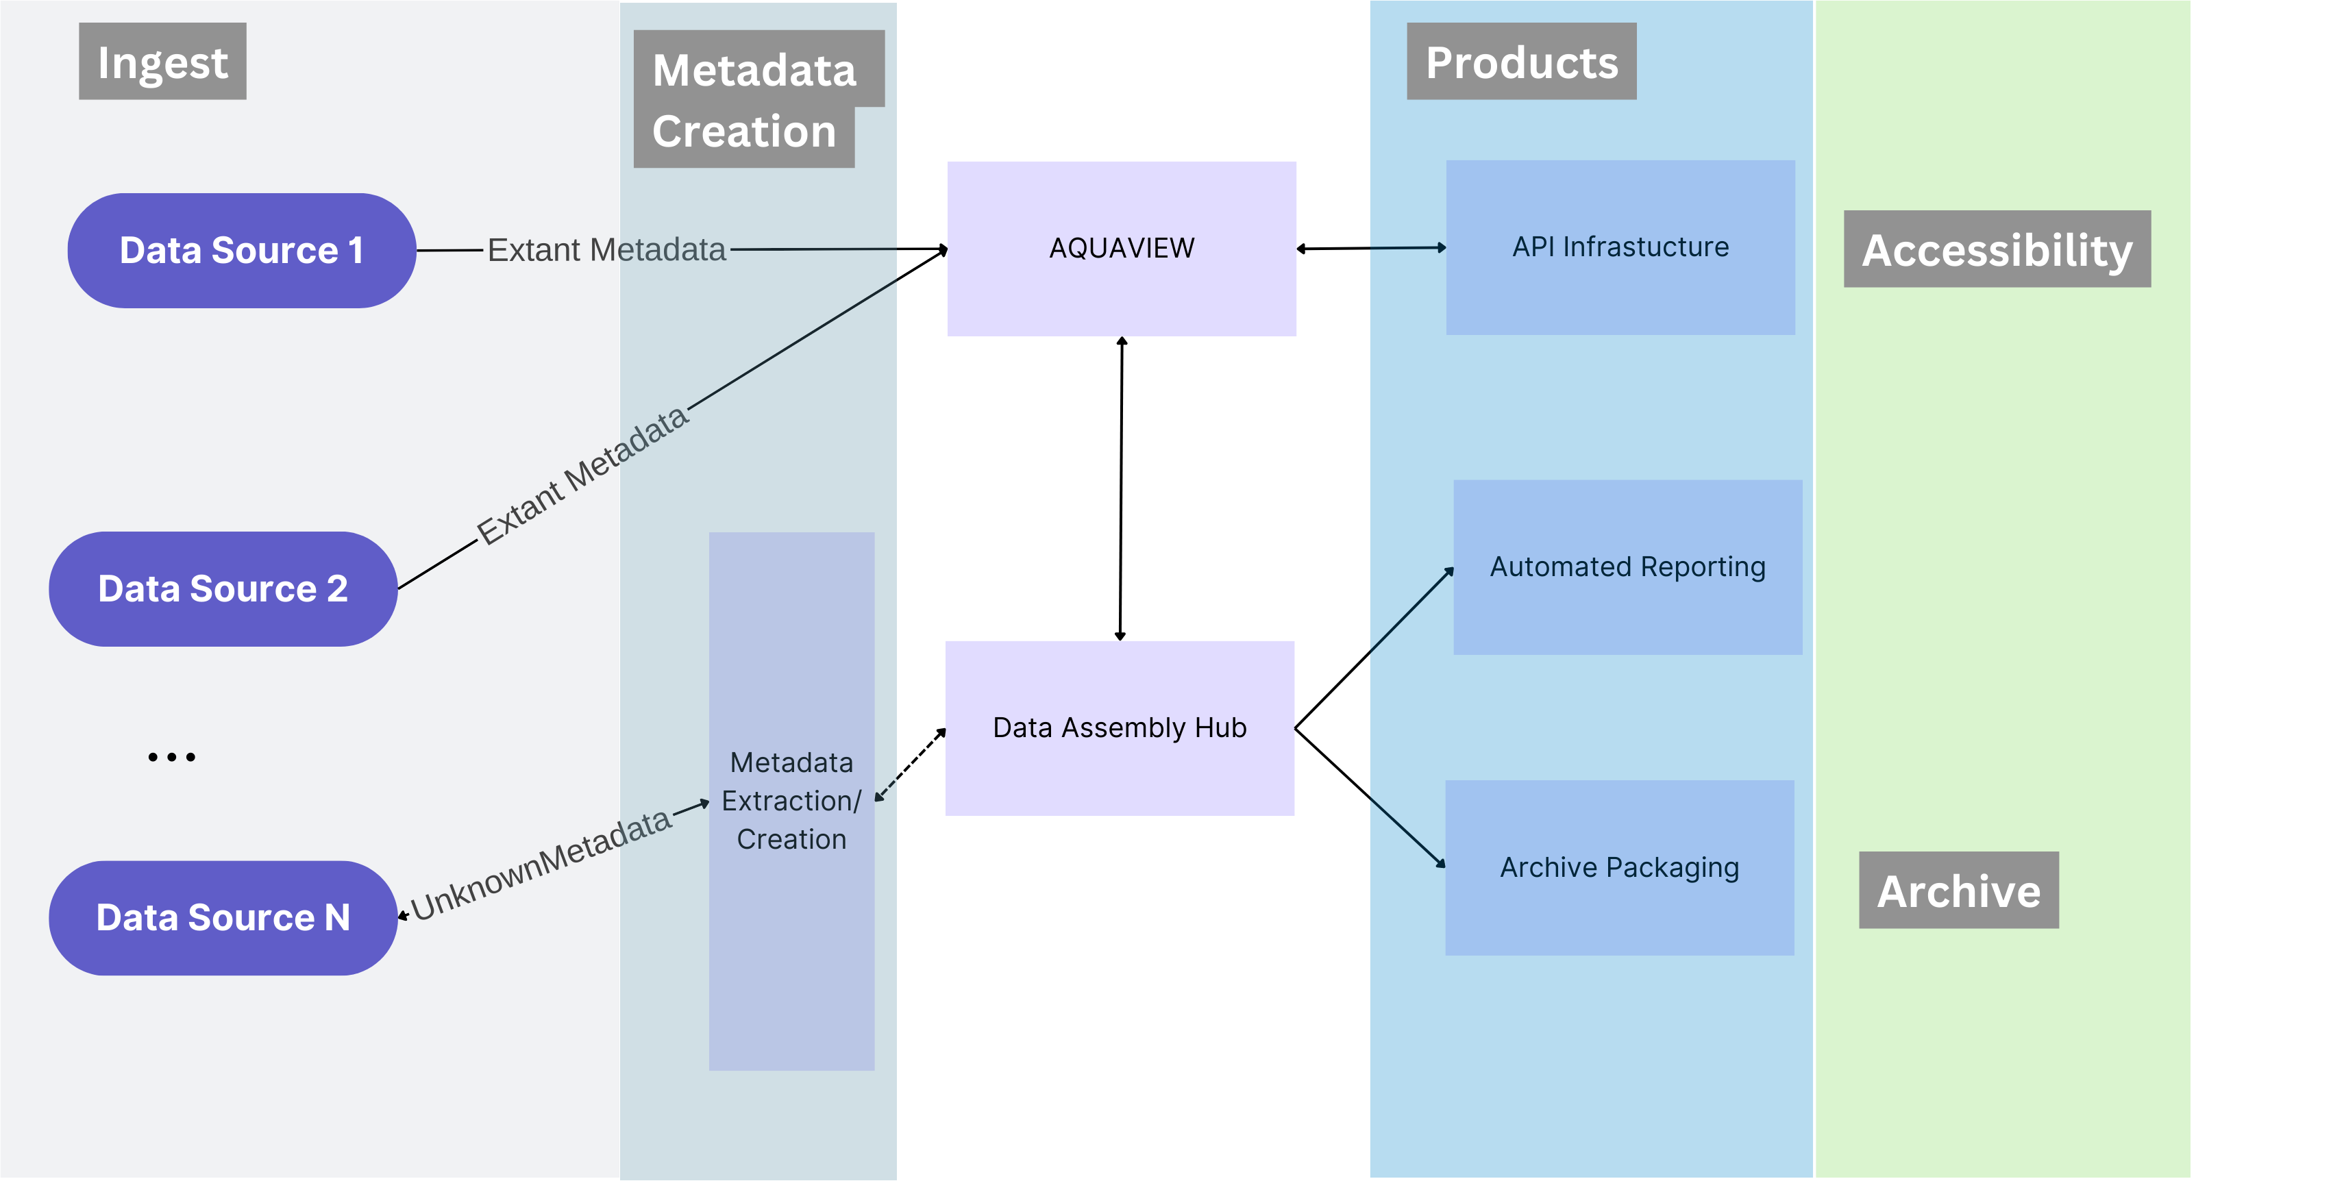
Two Components
AQUAVIEW
Prototype system developed as a metadata aggregator and API ecosystem for NOAA data
Uses S3 as data repository with MongoDB as metadata library
Proven system looking to expand data for testing and use
Data Assembly Hub
System beginning development in September 2023
Will provide repeatable data pipelines for report/archive package generation
Will operate with AQUAVIEW as metadata repository
Will generate metadata on ingest and provide AI ready data for use via AQUAVIEW’s API ecosystem

Slide 5
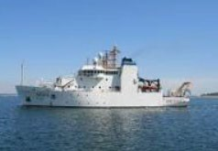


AQUAVIEW’s Current Data Delivery Model
(Also works with other cloud-based systems)
S3
(AWS)
Upload Methods
Near RT Uploads (OceanCube)
Older Data Ingestion
Federated Data
Meta Data Compilation and Access
AQUAVIEW API
Archiving
AQUAVIEW
External Partners
API’s allow for search GUI development and will allow scientists to build their own tools
Upcoming Data Assembly Hub work will allow for automated report generation/archive package development/deployment
External academic partners can use the uploaded data and metadata to initialize and/or ground-truth their regional ocean models or join with other data

Slide 6
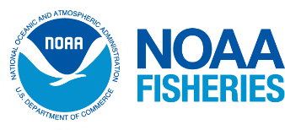
AQUAVIEW
Set of Python Applications/MongoDB for metadata storage coupled with federated cloud-based data
Collects and merges metadata from current operations or previously generated data
Can provide at or near-real-time support for data collections
Has API system to enable access from outside organizations with ability to limit data access via “tags” on specific datasets/types/etc.
Can enable purpose-built applications from database

Slide 7
Data Assembly Hub (Development starting Fall 2023)
Will provide for automated metadata extraction
Reproducible data pipelines (including data transformations, etc.) for report generation or other analyses
Git style change tracking to lower storage overhead
Formats/QC metadata for joining into the larger data system
Data access can be controlled via “tags” within the data system
Works with AQUAVIEW API system
Will allow for custom archive format script development for automation of archiving data

Slide 8
Initial Outcomes
AQUAVIEW+Data Assembly Hub will create a platform that achieves the following goals:
Demonstrate and learn how a federated cloud archive could be used to improve timely, efficient, and consistent access of data for broad use
Leverage cloud-based workflows to improve production of decision support tools, including ingestion, metadata creation, product development, archival packaging and accessibility
Build API ecosystems for use by scientists and other interested parties to develop products from NOAA Ocean Data
Create system where near-real-time feedback can be provided for data collection operations underway in a variety of environments

Slide 9
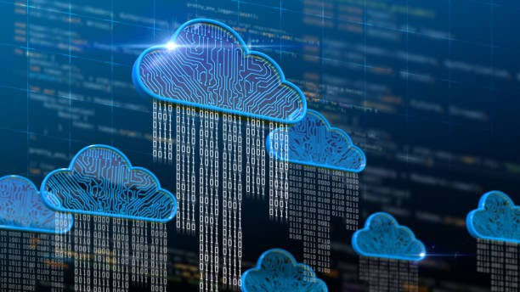
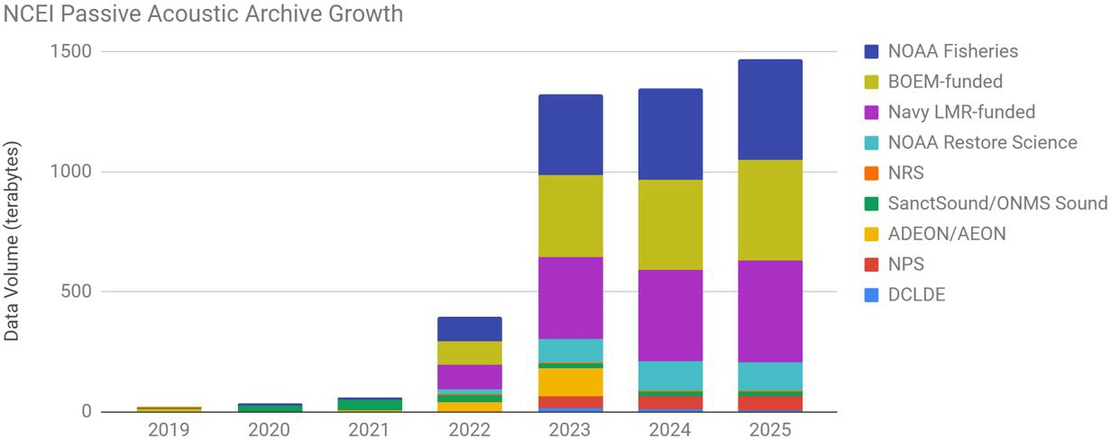

Goal #1: Federated Data in ‘the Cloud'
The Initiative will build scalable and innovative workflows to quickly document and integrate Fisheries’ metadata, with data residing in their distributed systems, into an integrated cloud-based architecture, with AQUAVIEW providing access to the integrated metadata and the Data Assembly Hub providing product pipelines for archives and scientific report generation
Alignment with NOAA priorities
The new FY22-FY26 NOAA Strategic Plan calls out the need for NOAA to support a digital New Blue Economy, specifical to ‘accelerate the growth in an information-based Blue Economy’.
To unleash the full potential of NOAA’s investment in observing systems and the agency’s vast collection of environmental data, NOAA must fully leverage transformative technologies including cloud infrastructure. This effort will allow the nation to fully exploit the potential of both new and old data by removing barriers to accessing, rapid result analyses, integrating and visualizing these large and complex datasets.
These volumes put a tremendous burden on NCEI on-prem
PAD Archive Growth Estimates

Slide 10
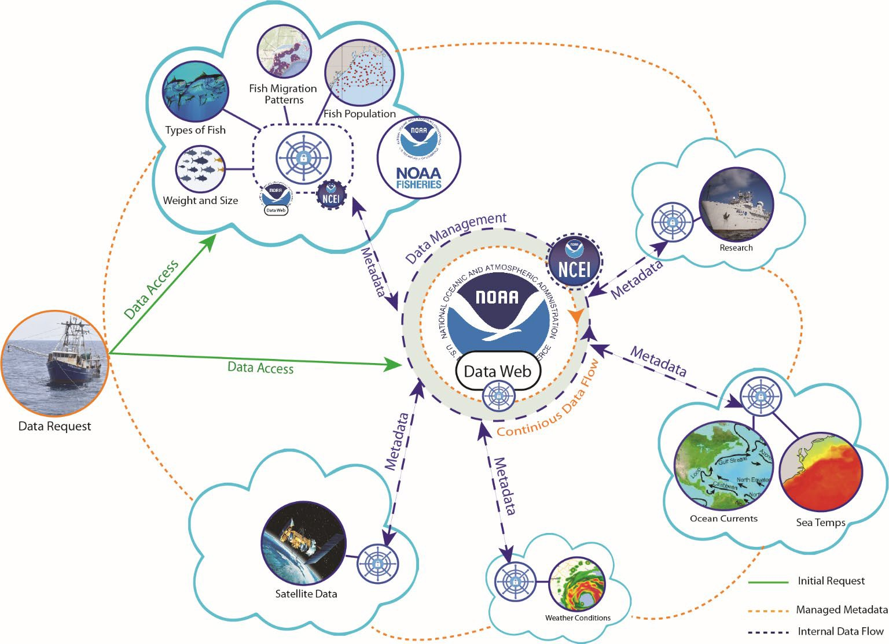
Federated Data Stewardship Potential Approach
NOAA Data Web
Program Vision: Partner to get NOAA data to the Cloud with enterprise data stewardship processes to create an authoritative, trusted data web that improves discovery, accessibility, interoperability, and reusability of NOAA data. Leverage Line Office (LO) knowledge, data management capabilities, and processing in tandem with NCEI data stewardship expertise to federate data stewardship.
Operation [Bluefin]: Build and launch to a Fisheries Cloud enterprise stewardship code that provides best practices for Cloud data stewardship, meets archiving requirements, and leverages commercial technology and NESDIS data management tools. Create interfaces with Fisheries data management systems (ex. InPort) and ensure it is replicable for other LOs for future launches.
Enabling Science Products: Enable cross-discipline data discovery, research, and blended products through data connection and interoperability. Demonstrate this capability by improving scientific workflows and creating or enabling a Digital Twin Earth.

Slide 11
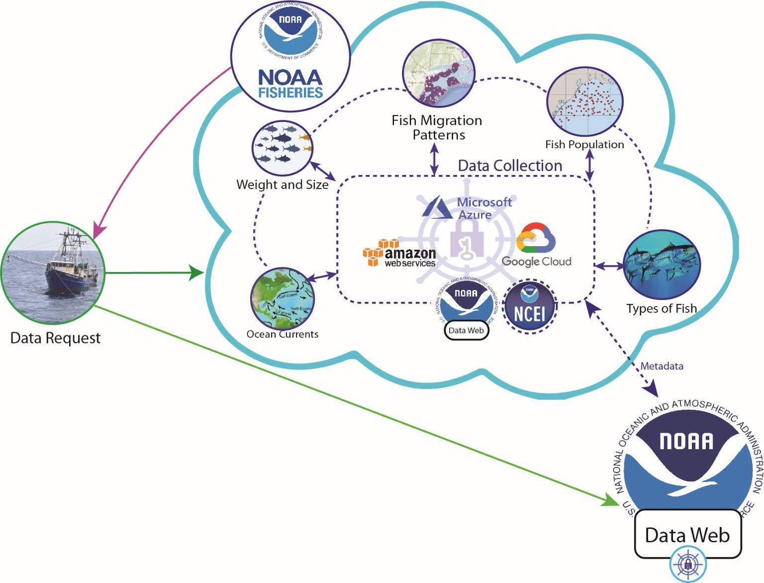
Stewardship Enterprise Web Design
Standardized set of Cloud-ready, CSP-agnostic code for data stewardship that can be deployed in LO Clouds
Interface and associated software can be tailored to the LO (ex. InPort)
Overall NOAA Catalog and Access Aids will be populated, further Access tailored by LO
NCEI provides assists with code deployment, provides expertise to the LO on the interface and best practices, maintains authority to approve and manage archived datasets, and operating and maintaining the code

Slide 12
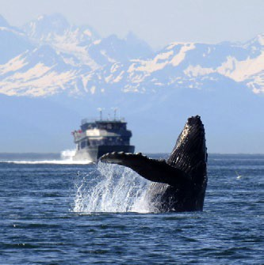
Why a federated model is preferred over the traditional data delivery to the archive:
Prevents unnecessary copying/duplication of high volume data sets
Allows for seamless integration with multiple NOAA cloud efforts
Preserves the relationship between archive and provider
Potentially allows broader federation and integration with local data
Allows for direct access to the data for AI/ML applications
The OCEAN Initiative will break down barriers and streamline information to make data work for NOAA Fisheries.

Slide 13
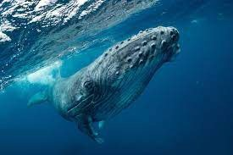
Goal #2: Develop scientific products in cloud-based workflows
In coordination with NOAA Fisheries and the larger NOAA ocean science community, research/data scientists will develop distributed cloud-based workflows based on the USM Data Assembly Hub that add value and understanding to the collective ocean acoustic archive under this initiative.
Proven Success
Allen et al. (2021) applied a convolutional neural network to
extract humpback whale song from passive acoustic monitoring data collected at 13 sites in the North Pacific Ocean over 14 years. The project was a collaboration between Pacific Islands Fisheries Science Center and Google with a supporting role from NCEI. The model produced identified sounds that would have never been detected based on current processing methods. Namely, the model discovered faint and rare-occurring humpback whale song in Kingman Reef – a location where humpback whales have never been documented before. Through AI, this group added to the broader understanding of humpback whale distributions and vocal activity that would have not otherwise been possible.
This initiative’s scientific processing routines established in a scalable, cost-effective, cloud environment and connected to large centralized repositories of data will support NOAA Fisheries in developing fully automated end to end solutions for monitoring, including automated species composition and products that impact fisheries. Through the use of AI, scientists will be able to get to answers faster and more accurately leading to faster management decisions.

Slide 14
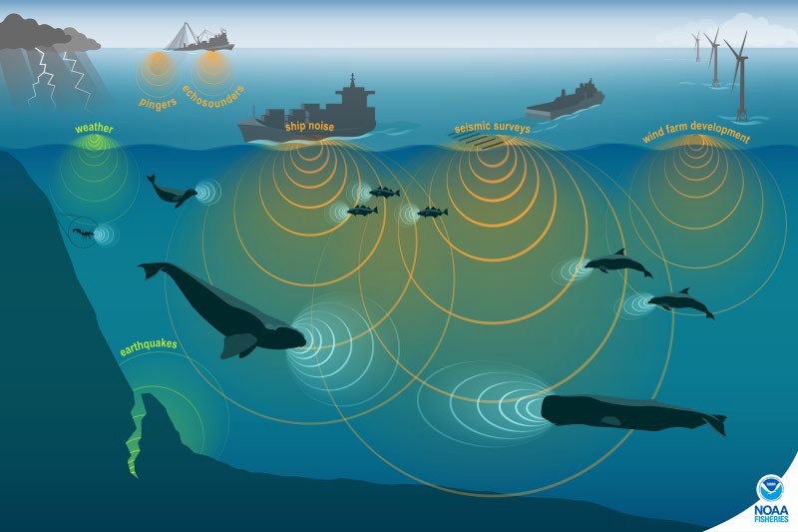
Goal #3: Enable cloud-based discovery and access
To ensure the sustainability of cloud-based access for data archives, especially in light of their promised petabyte- plus growth in the coming years, this goal will focus on shifting access points to a distributed cloud . Data discovery enhancements will include the discovery of the NESDIS cloud and relevant NOAA Fisheries cloud repositories from a single data portal page, and will be driven by standards-driven metadata and dynamic search capabilities. In addition to the raw data, data products - including those created through the OCEAN Initiative - and the annotation repository will also be discoverable from the data portal. Tools to extract queried subsets of the archive holdings will be created to facilitate analysis and feed models.
AQUAVIEW currently supports a search GUI that facilitates dynamic data updates and searching across federated data systems including AWS S3 buckets and Azure-based data systems. With the addition of the Data Assembly Hub, this reach will grow to include existing archives and other NOAA database systems both in the cloud and in on-prem storage.
Proven Success
Wall et al (2021) applied standardized processing routines to
create comparable soundscape metrics from three separate passive acoustic monitoring projects conducted at regional and national scales. This analysis would not have been attainable without the NCEI passive acoustic archive’s standards-based metadata and centralized stewardship and access.

Slide 15

Goal #4: Promote equitable dissemination
One of the three major priority areas of the FY22-FY26 NOAA Strategic Plan is to integrate equity into core operations.
The Initiative will advance equitable dissemination of NOAA’s data. Through free and global access to large volumes of diverse acoustic datasets, barriers to data acquisition will be removed for underserved communities and entities that lack significant, sustained funding sources necessary for most monitoring projects. In addition, the availability of enhanced products and models will greatly lower the resources necessary to interrogate the data. Scientists from all over will be uniformly able to develop creative analyses and outputs that further the field of marine bioacoustics.
Under the FAIR (Findable, Accessible, Interoperable, Reproducible) rubric, scientists from across the spectrum will be able to take advantage of NOAA Fisheries data, helping to better serve underserved communities.
Proven Success
NOAA generates tens of terabytes of data a day from
satellites, radars, ships, weather models, and other sources. While these data are available to the public, it can be difficult to download and work with such large data volumes. NOAA’s wealth of data therefore represents a substantial untapped economic opportunity. The NOAA Open Data Dissemination Program provides public access to NOAA's open data on commercial cloud platforms through public-private partnerships. These partnerships remove obstacles to the public use of NOAA data, help avoid costs and risks associated with federal data access services, and leverage operational public-private partnerships with the cloud computing and information services industries.

Slide 16
FY Year Program Milestones
FY23: Implement workflows to allow archiving the data in a federated cloud environment following NARA/OAIS standards.
FY24: 50% of NOAA Fisheries acoustic data uploaded to a cloud with structured documentation. Archived datasets will be publically discoverable and searchable
FY25: 95% of NOAA Fisheries acoustic data uploaded to a cloud. Implement cloud- based workflows and sharable toolkits to create AI-Ready data and AI models and physics-based analyses from the cloud-hosted acoustic data
FY26: Operationalize a unified approach to data management, data access, data science and machine learning that is open and interoperable across cloud platforms

Slide 17
Program Budget
Placeholder

Slide 18
Risk Reward
This is a high reward project with some risk
Could potentially accelerate the migration to the cloud and be a defining model
How federated stewardship will work and the integration with outside applications has only been explored in a limited fashion
No clear funding line
If successful other data integrates relatively easily into the cloud
Could lead to full integration cross NOAA in 5 years
Strongly supports partnerships across USG
If not successful the lessons of why not are invaluable and quickly delivered
However ties up developers that could be working on a traditional model
Raises business mode questions on long term resourcing

Slide 19
Next Steps
Agreement to proceed
Define initial data targets
Identification of Funding Sources
Does it fit with IRA?
How quickly can we allocate to start in FY-23
Engineering
How does the Azure CRADA potentially support this?
Agile development with designated stakeholders
Evaluate lessons learned and explore expanding the concepts to the rest of NOAA

Slide 20
Background/Backup Slides

Slide 21
External Drivers
2010: NOAA Administrative Order (NAO), 212-15, “Management of Environmental Data and Information” revised to establish a new framework for environmental data management in NOAA. Environmental Data Management Committee (EDMC) created.
2013: EDMC publishes NOAA Environmental Data Management (EDM) Framework, which defines key principles that NOAA data should be fully and openly available to all users, preserved for long-term use, well documented and of known quality, and easy to use. (There are now six Procedural Directives)
2013/2015: White House OSTP Memorandum on Increasing Access to the Results of Federally Funded Scientific Research. Followed by the NOAA Plan for Increasing Public Access to Research Results.
2017: NESDIS Environmental Data Management Planning Policy Approved
2018: The Evidence Act (FEBPA) passed, putting into law what previously had been Executive Orders and OMB memos, requiring that government data be open by default, cataloged, accessible, and machine-readable.
2020: NRL REQ-004 - NESDIS will ensure the quality, accuracy, reliability, preservation, discoverability, and accessibility of the Nation’s historical sensor, environmental, and model data archives consisting of data from NOAA, U.S., and global observing systems.
2022: White House OSTP updated and released PARR with Ensuring Free, Immediate, and Equitable Access to Federally Funded Research

Slide 22
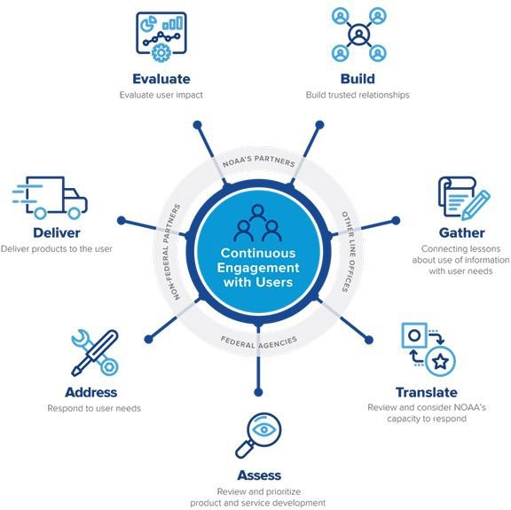
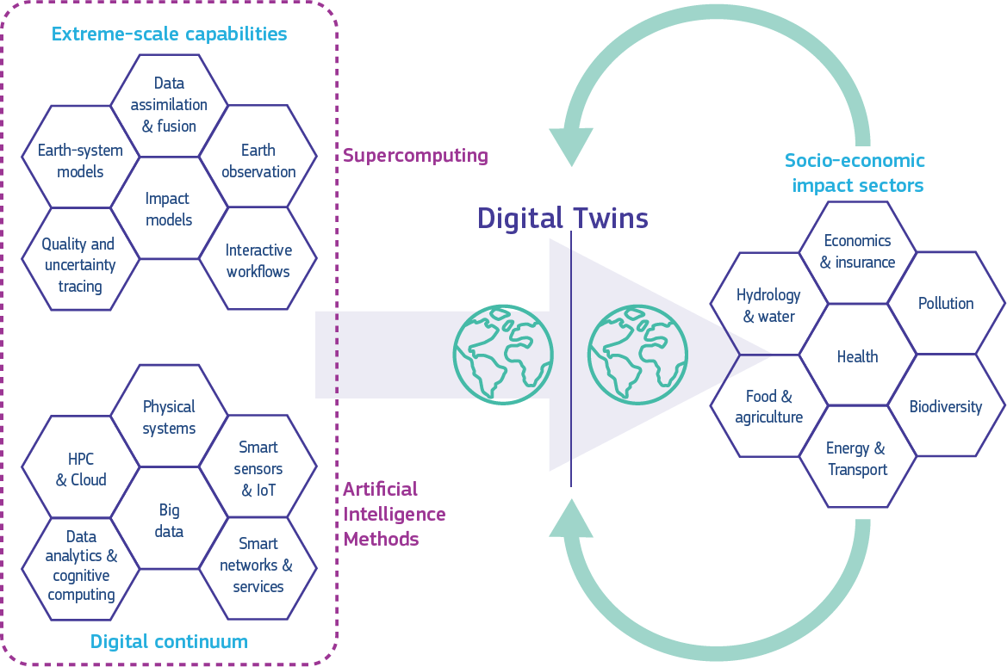
Leverage the NOAA Service Delivery Framework

